Slide 1


Project Presentation on “Customer Retention”
Presented by Manjunath Aparoji

Slide 2

Agenda:
Overview.
What is customer Retention?
Need of customer retention.
Problem Statement.
Problem Understanding.
Exploratory data analysis.
Data cleaning.
Visualization.
Conclusion.

Slide 3
1. Overview:
In this particular presentation we will be looking on:
How to analyze the dataset of Customer Retention
What are the criterion to achieve Customer Retention
Overall analysis on the problem.

Slide 4
2. What is Customer Retention?
Customer retention is a metric that measures customer loyalty, or the ability for an organization to keep its customers over time. In addition to identifying the number of loyal customers, customer retention can reflect or predict customer satisfaction, repurchase behavior, customer engagement and emotionally ties to a brand.

Slide 5
3. Need of Customer Retention:
Less spending on customer acquisition : Acquiring a new customer can be up to five times more expensive than retaining an existing one.
Increased profits : An increase in client retention by 5% can enhance profits by over 25% .
Improved online reputation : Over 37% of customers will only post online reviews if they are “extremely satisfied”.
Positive Reviews : The longer customers stay with a company, the more business, positive reviews, and they bring word of mouth advertising.

Slide 6
4. Problem Statement:
Customer satisfaction has emerged as one of the most important factors that guarantee the success of online store; it has been posited as a key stimulant of purchase, repurchase intentions and customer loyalty. A comprehensive review of the literature, theories and models have been carried out to propose the models for customer activation and customer retention. Five major factors that contributed to the success of an e-commerce store have been identified as: service quality, system quality, information quality, trust and net benefit. The research furthermore investigated the factors that influence the online customers repeat purchase intention. The combination of both utilitarian value and hedonistic values are needed to affect the repeat purchase intention (loyalty) positively.

Slide 7
5. Problem Understanding:
Customer retention means the process of maintaining or keeping customers once you have acquired them. It’s all the activities that a company must do in order to keep their customers around. The goal is to build a long-lasting relationship between the brand and consumers. Once a customer becomes loyal to your brand, not only he will buy more from you than a normal customer but he’ll spread good words about your business, increase your reputation. Thus in this perticular problem solution I have used all my analysation skills to solve the problem of customer retention.

Slide 8
6. Exploratory data analysis:
I have imported the dataset which was in excel format. Then I did all the statistical analysis like checking shape, nunique, value counts, info etc…..
Then while looking into the value counts I found some duplicate entries in the features i.e., two words with same meaning. I have replaced those duplicates by grouping them.
I have checked for null values but there was no null values in the dataset.

Slide 9
7. Data Cleaning:
Also the data type of pin code column was integer type but pin code is a code which will be given to perticular location and it will be unique so the datatype should object. So I have changed the datatype of pin code column if I don’t change the datatype it will carry some wrong information and it may also affect my model accuracy.

Slide 10
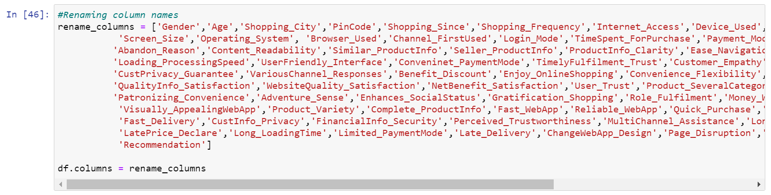
7. Data Cleaning:
And the column names are very descriptive and they look hard to handle with unnecessary spacing so I have changed my column names which will be helpful for further studies.

Slide 11
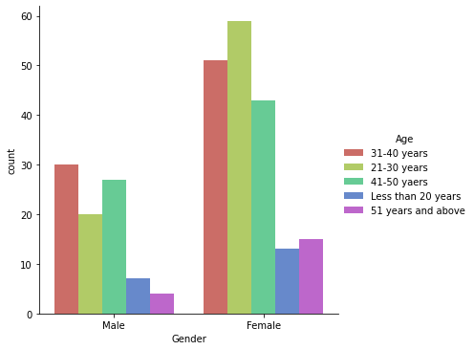
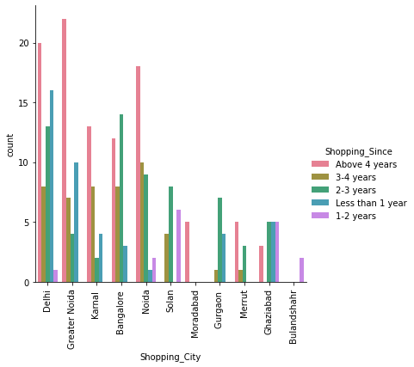
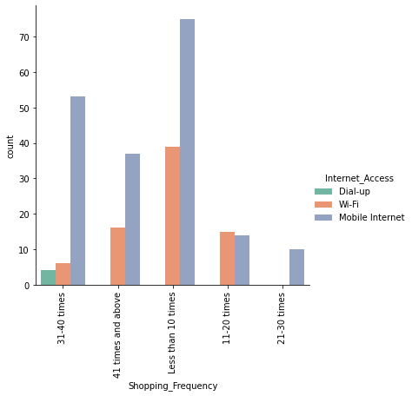
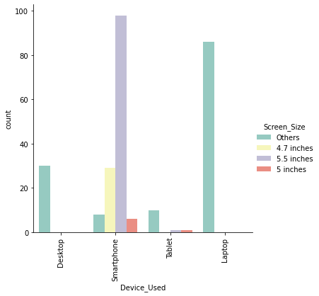
8. Vizualization:

Slide 12
8. Vizualization:
Female are doing more shopping compared to men and females with age group 21-30 and men of age group 31-40 are shopping more than other age groups.
I found more customers in Great Noida and they belong to above 4 years of online shopping experience.
In all the frequencies of online purchase in past 1 year the usage of mobile internet for internet access is having high count.
All the smartphone users has maximum count for 5.5 inches screen size and for all other devices screen size is not specified i.e., others option.

Slide 13
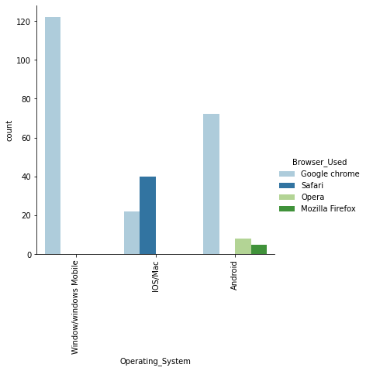
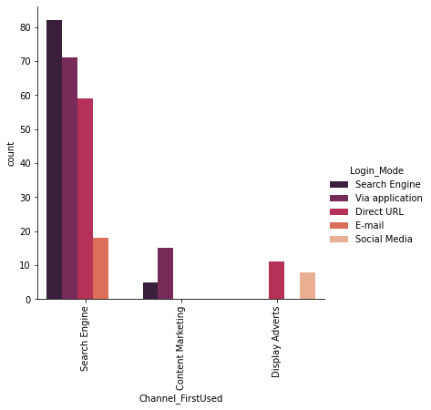
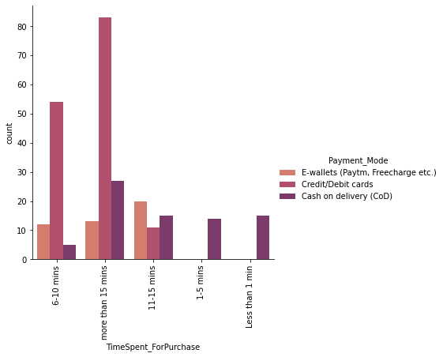
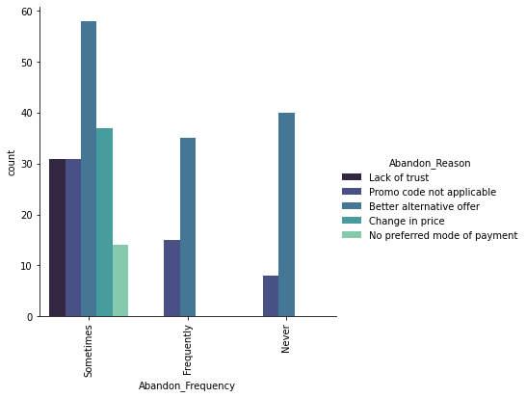
8. Vizualization:

Slide 14
8. Vizualization:
All the window users and max Android users uses Google Chrome as there browser and IOS/Mac users use Safari as there browser.
Maximum customers uses Search Engine to visit the online store for first time and after first visit also again they login using search engines so search engines are the good mode to get hike in number of customers.
Maximum customers uses the e-retail shop for more than 15 mins to make purchase decision and max customers uses credit/debit card as payment option.
Maximum customers sometimes abandon and the maximum reason for abandons is to get better alternative offer.

Slide 15
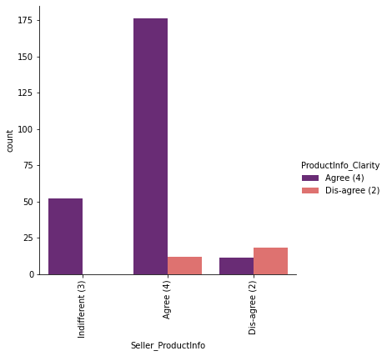
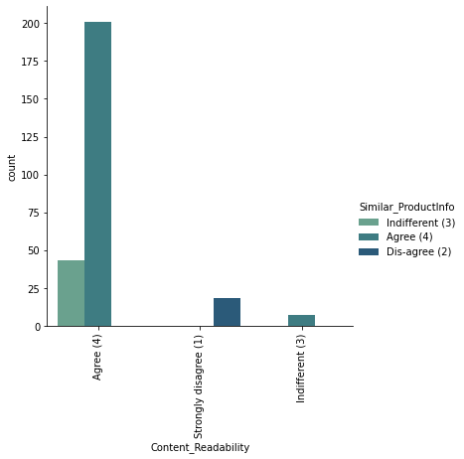
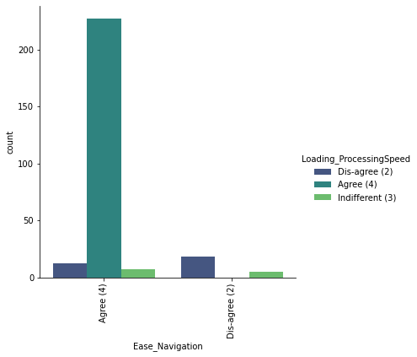
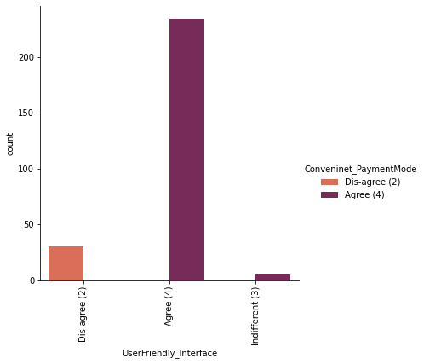
8. Vizualization:

Slide 16
8. Vizualization:
Maximum customers agrees to have the content on the web page to be easy to read and understand and also they agrees to get information on similar product to the one highlighted is important for product comparison.
Maximum people agrees to have all relevant information on listed products and agrees with complete information on listed seller and product being offered is important for purchase decision.
Maximum customers agrees to get easy navigation in website and they wants to have loading and processing speed.
Maximum customers wants user friendly interface of the website and convenient payment methods.

Slide 17
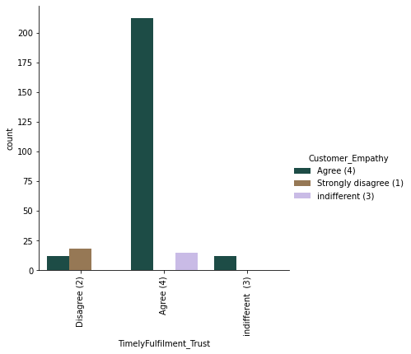
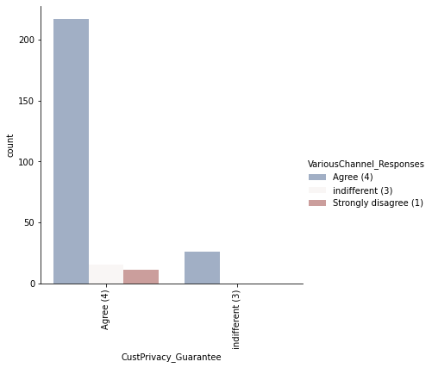
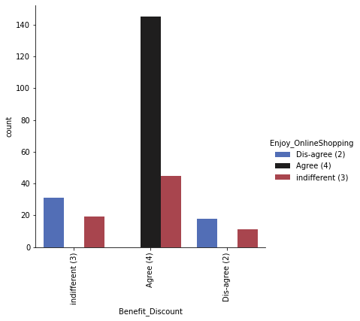
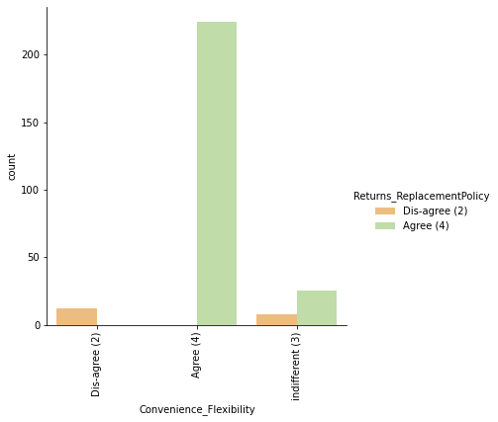
8. Vizualization:

Slide 18
8. Vizualization:
Maximum customers agrees to get Trust that the online retail store will fulfil its part of the transaction at the stipulated time and expects Empathy towards the customers.
Maximum customers wants to have the guarantee privacy of the customer and they wish to have Responsiveness, availability of several communication channels.
Maximum customers agrees that Online shopping gives monetary benefit and discounts and they also agrees that Enjoyment is derived from shopping online.
Maximum customers agrees that shopping online is convenient and flexible and they also agrees that return and replacement policy of the e-tailer is important for purchase decision.

Slide 19
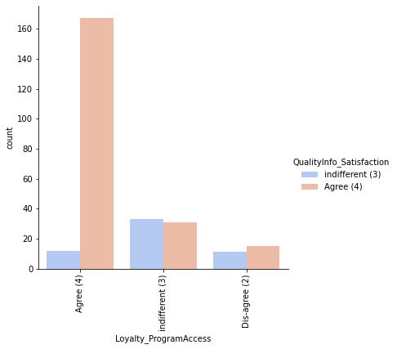
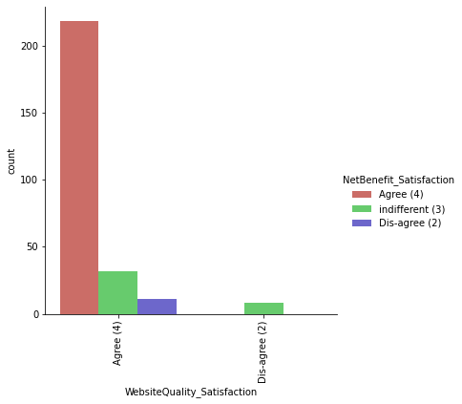
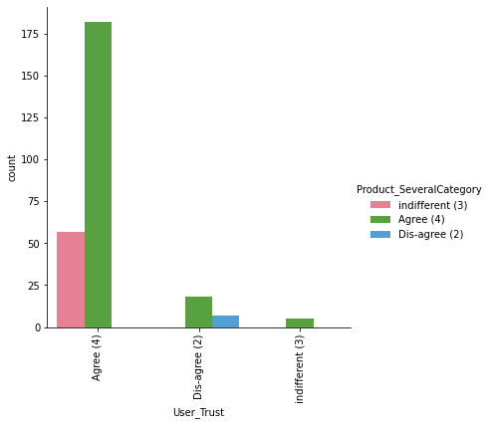
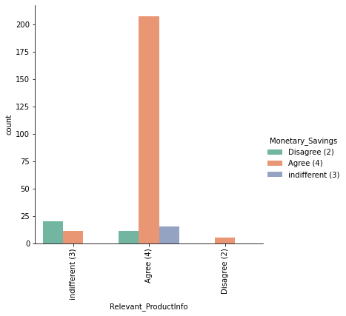
8.Vizualization:

Slide 20
8. Vizualization:
Max customers agrees with Gaining access to loyalty programs is a benefit of shopping online and they also agrees that displaying quality information on the website improves satisfaction of customers.
Maximum customers agrees that user derive satisfaction while shopping on a good quality website or application and they also agrees that net benefit derived from shopping online can lead to users satisfaction.
Max customers agrees to have user satisfaction cannot exist without trust and they also agrees that offering a wide variety of listed product in several category.
Max customers agrees to have provision of complete and relevant product information and they also agrees to have monetary savings.

Slide 21
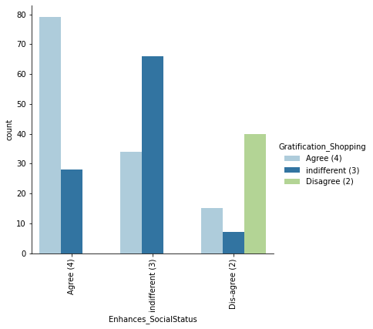
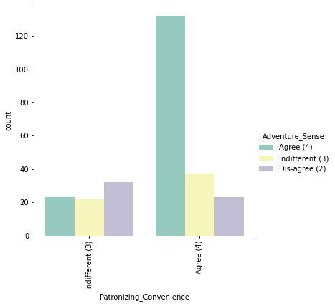
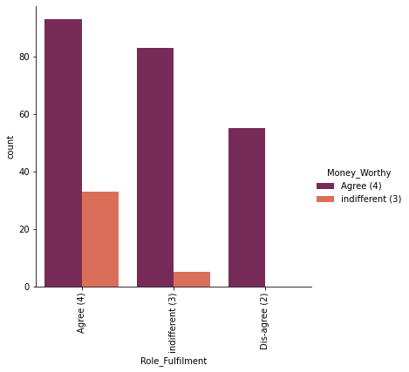
8. Vizualization:

Slide 22
8. Vizualization:
Max customers agrees for having the convenience of patronizing the online retailer and they also agrees that shopping on website gives us the sense of adventure.
Max customers agrees that we feel gratification shopping on there favourite e-tailer and they also agrees that shopping on your preferred e-tailer enhances there social status.
Max customers agrees shopping on the websites helps to fulfil certain roles and they also agrees that getting value for money spent.

Slide 23
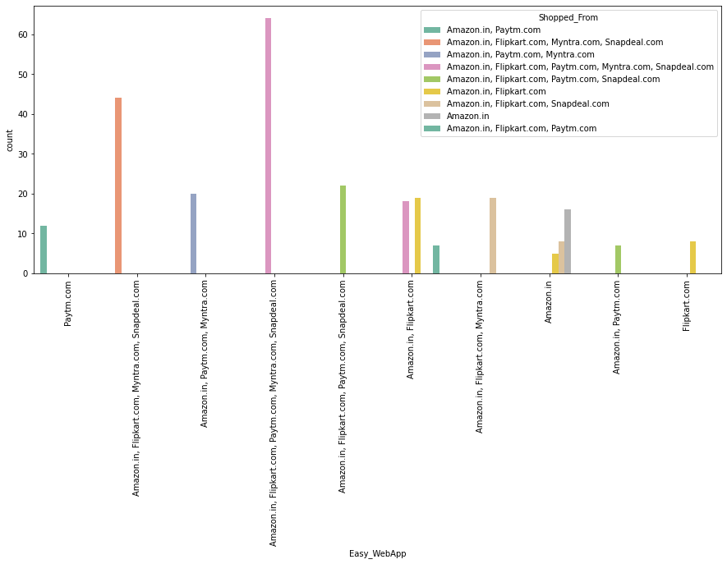
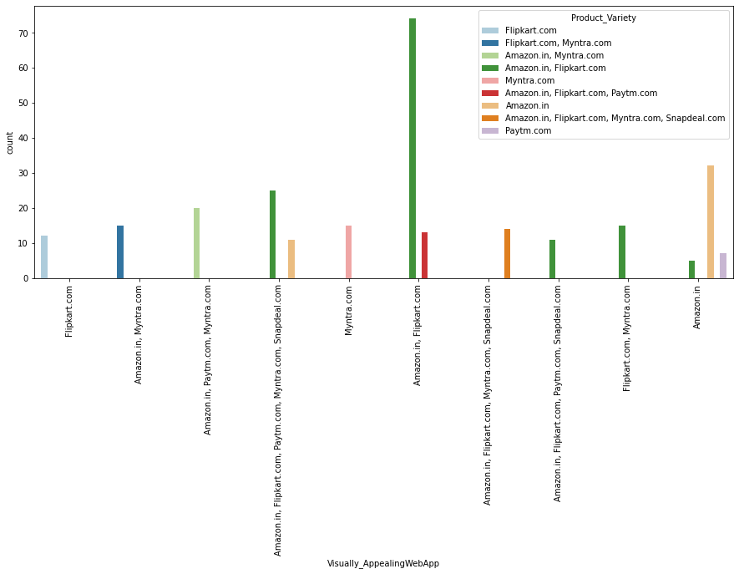
8. Vizualization:

Slide 24
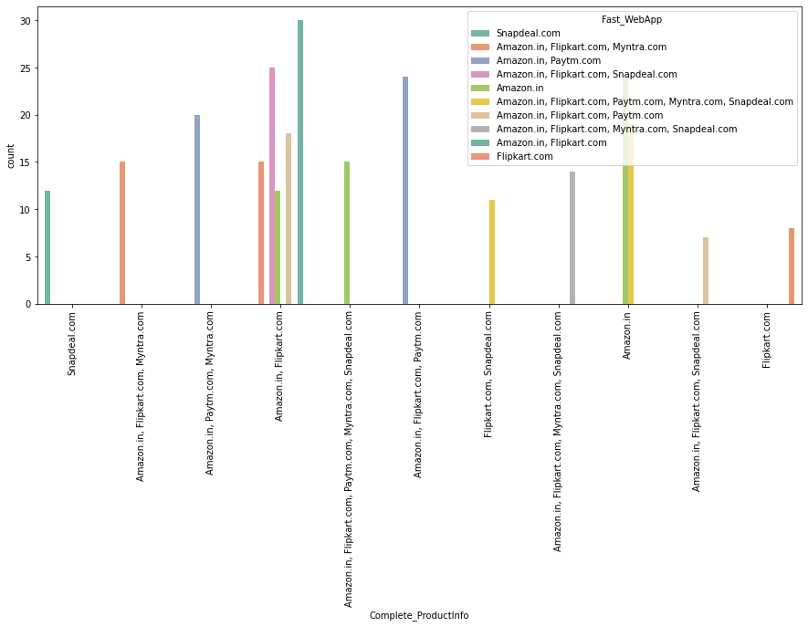
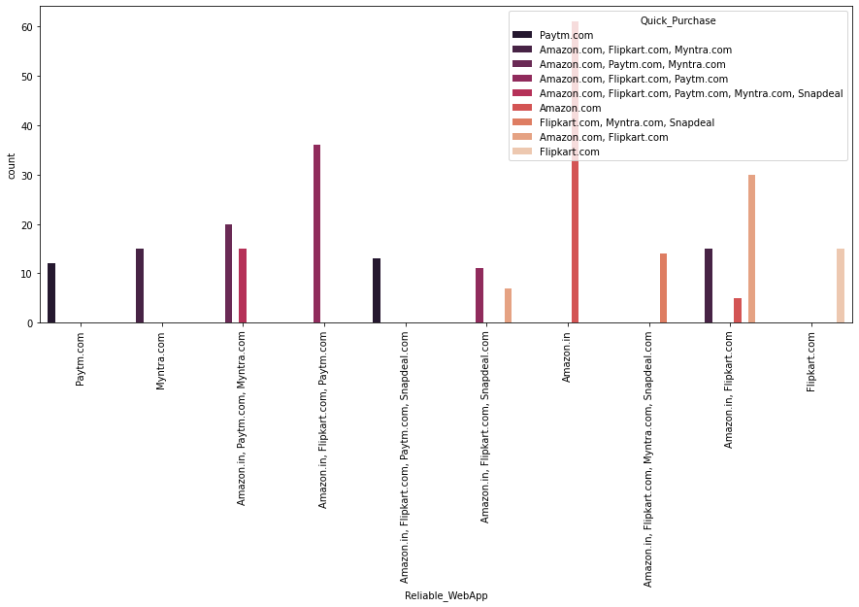
8. Vizualization:

Slide 25
8. Vizualization:
Max customers choosed that all the available online shopping platforms are easy to use and they also shop from all the online shopping websites.
Maximum customers choosed Amazon and Flipkart as best visual appealing web-page layout and best platform which gives wide variety of product on offer.
Most of the customers chooses Amazon and Flipkart as the best platform that gives complete relevant description information of products and also they choosed Snapdeal as the fast loading website.
Max customers says that Reliability of the website or application and quickness to complete purchase is good with Amazon.

Slide 26
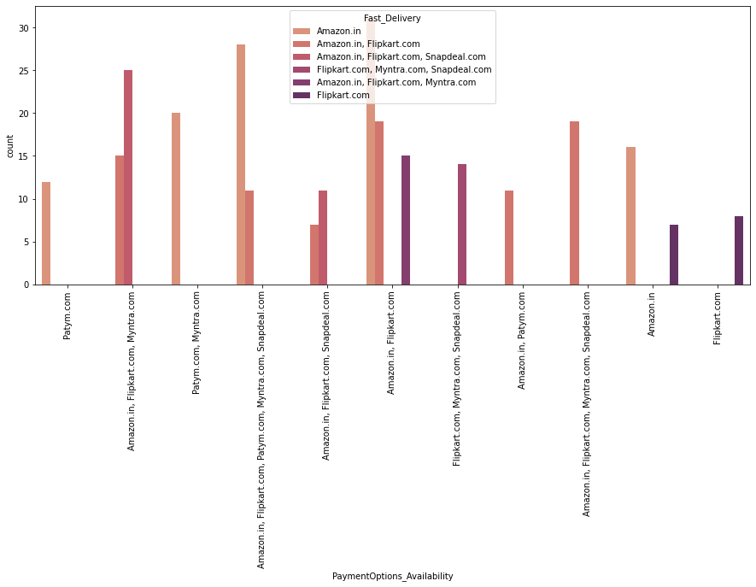
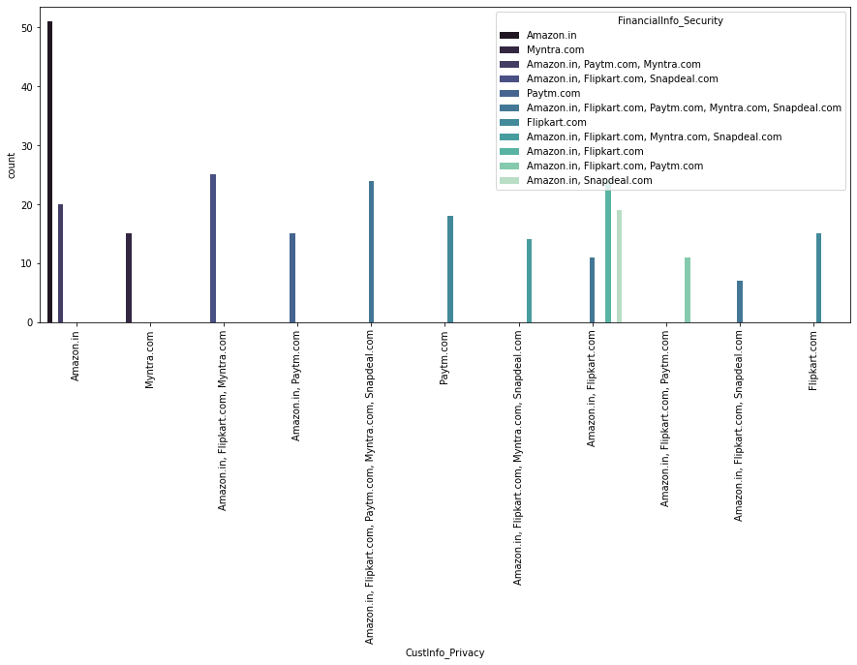
8. Vizualization:

Slide 27
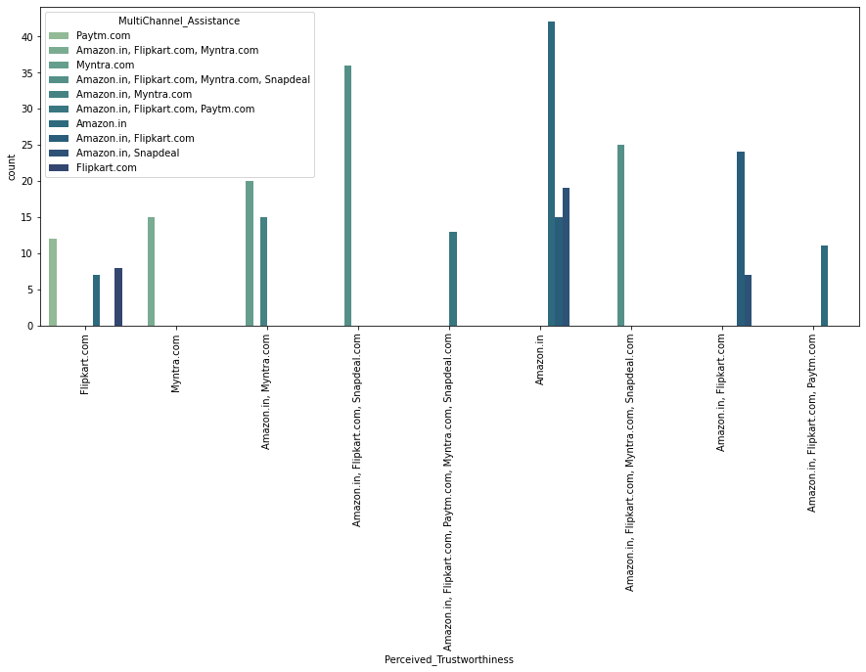
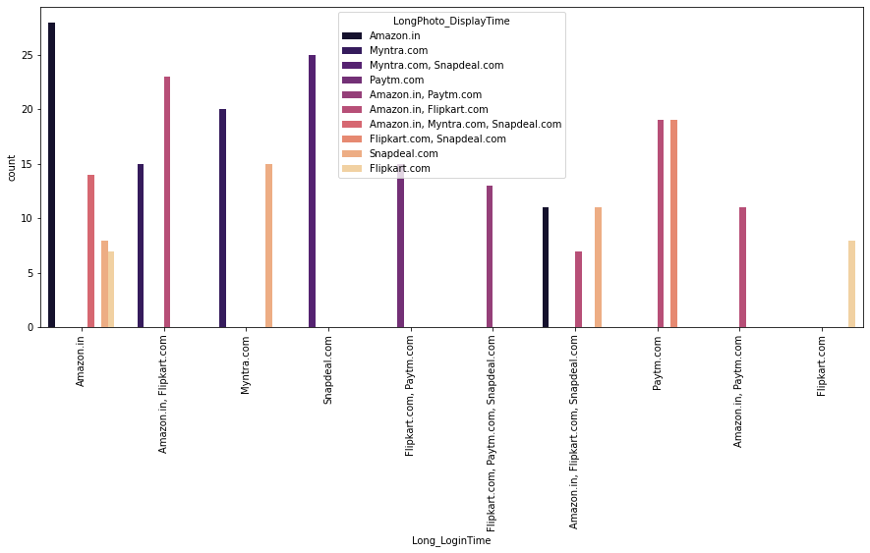
8. Vizualization:

Slide 28
8. Vizualization:
Max customers chooses Amazon and Flipkart as having best payment option available and also they are giving fastest delivery also.
Max customers chooses Amazon for giving best customers information privacy and also for giving best financial information security.
Amazon is the best online shopping mart which gives perceived trustworthiness and it has the presence of online assistance through multi-channel.
Since Amazon is the busiest online shopping platform it is also having drawback of taking longer time to login and taking longer time in displaying graphics and photos.

Slide 29
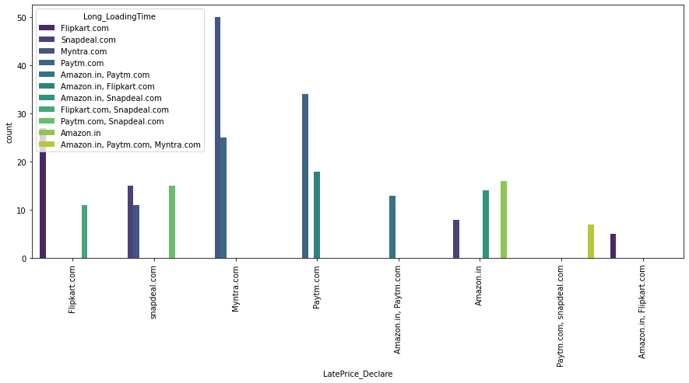
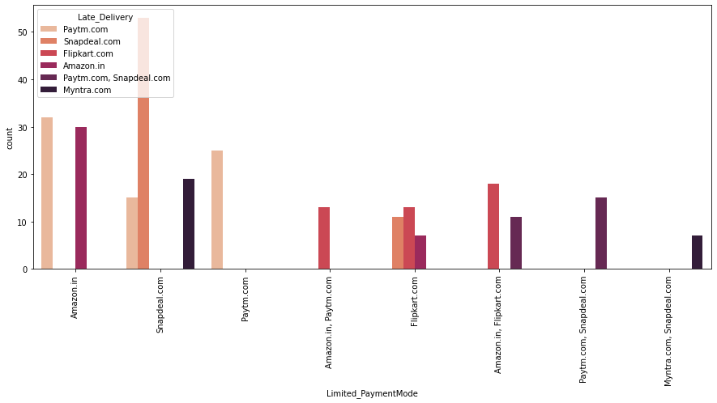
8. Vizualization:

Slide 30
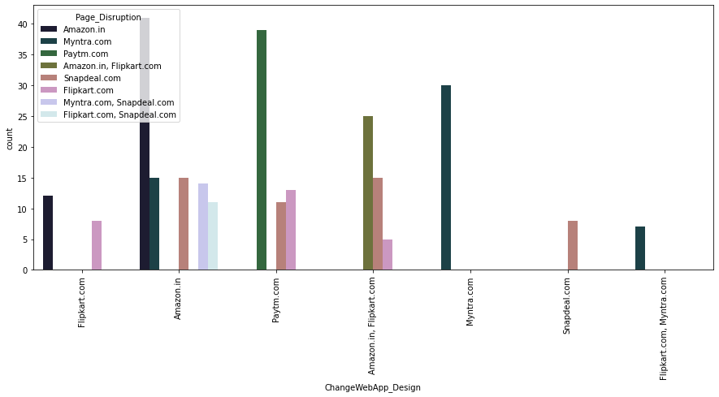
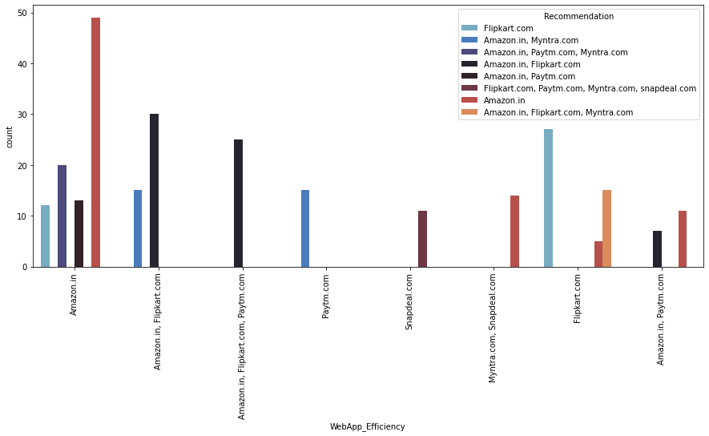
8. Vizualization:

Slide 31
8. Vizualization:
Max customers says that the drawback of having late declaration of price is with Myntra and longer page loading time is with Flipkart.
Snapdeal has a drawback of having limited payment modes and also it has a complaint of late delivery.
Max customers says that Amazon is the platform with good wedsite/application design and also amazon has a drawback of disruption of pages when moving from one page to another.
Max customers says that the efficiency of website is good with Amazon and also amazon is recommended by most of the customers.

Slide 32
9. Analysis:
Most of the customers are females with age from 20-50 and they used mobile internet to access with Windows as operating system.
And most of the customers used search engines to get into the platform first time and frequently.
Max customers uses there debit/credit cards for there payment.
Almost customers has a expectation to have Content_Readability, Similar_ProductInfo, Seller_ProductInfo, ProductInfo_Clarity, Ease_Navigation, Loading_ProcessingSpeed, UserFriendly_Interface, Conveninet_PaymentMode, TimelyFulfilment_Trust, Customer_Empathy, CustPrivacy_Guarantee, VariousChannel_Responses, Benefit_Discount, Enjoy_OnlineShopping, Convenience_Flexibility, Returns_ReplacementPolicy, Loyalty_ProgramAccess, QualityInfo_Satisfaction, WebsiteQuality_Satisfaction, NetBenefit_Satisfaction, User_Trust, Product_SeveralCategory, Relevant_ProductInfo, Monetary_Savings, Patronizing_Convenience, Adventure_Sense, Enhances_SocialStatus, Gratification_Shopping, Role_Fulfilment, Money_Worthy in e-commerce websites.

Slide 33
9. Analysis:
Compared to other platforms shopping with Amazon.in and Flipkart.com has maximum benefits rather than drawbacks.
Compared to all other online shopping platforms Snapdeal and Myntra has maximum drawbacks.
And having maximum good feedbacks Amazon is recommended by most of the customers.

Slide 34
10. Conclusion:
While going through the problem and in detailed analysis I found the following conclusions:
Females are furious to shop all the time so making them satisfied will help the sellers to get more business.
Loyal customers prefer buying and tend to spend more money on shopping in your store. Statistics show that engaged consumers purchase more frequently. It is necessary to hear customer feedback because most of them are valuable feedbacks.
Sometimes customer feedback is the best marketing strategy. They are frequent customers so they will know which areas of your business may well be improved. If their feedback is approved, they will extremely excite and support your company with their best ability.

Slide 35
10. Conclusion:
Here as an conclusion part I found that using dead old strategies for retailers will effect customer retention.
Organisation will always focus on success for that keeping the old customers will always be a plus point.
Also Paytm and Snapdeal has maximum drawbacks it is because of their dead old strategies.
I found Amazon and Flipkart are standing best out in the market by using ethical, reasonable business strategies.
To conclude, having the right customer retention strategy will keep sellers company growing if they know how to take advantage of it. Then customers will find their way back and continue buying stuff from the best company.

Slide 36



